Slide 1
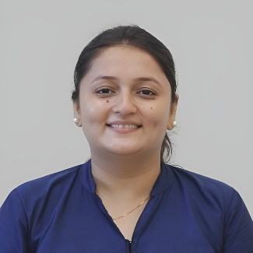
Para Jumble
TCS Placement Practice
Prof. Radhika J Bhateliya
Humanities and Science Department
radhika.bhateliya@darshan.ac.in
9428035992

Slide 2

Looping
Topics
  Tips
  Practice

Slide 3
Para Jumble
Notes:
Gif Reference: https://tenor.com/view/tkthpsharma-gif-23317246

Slide 4
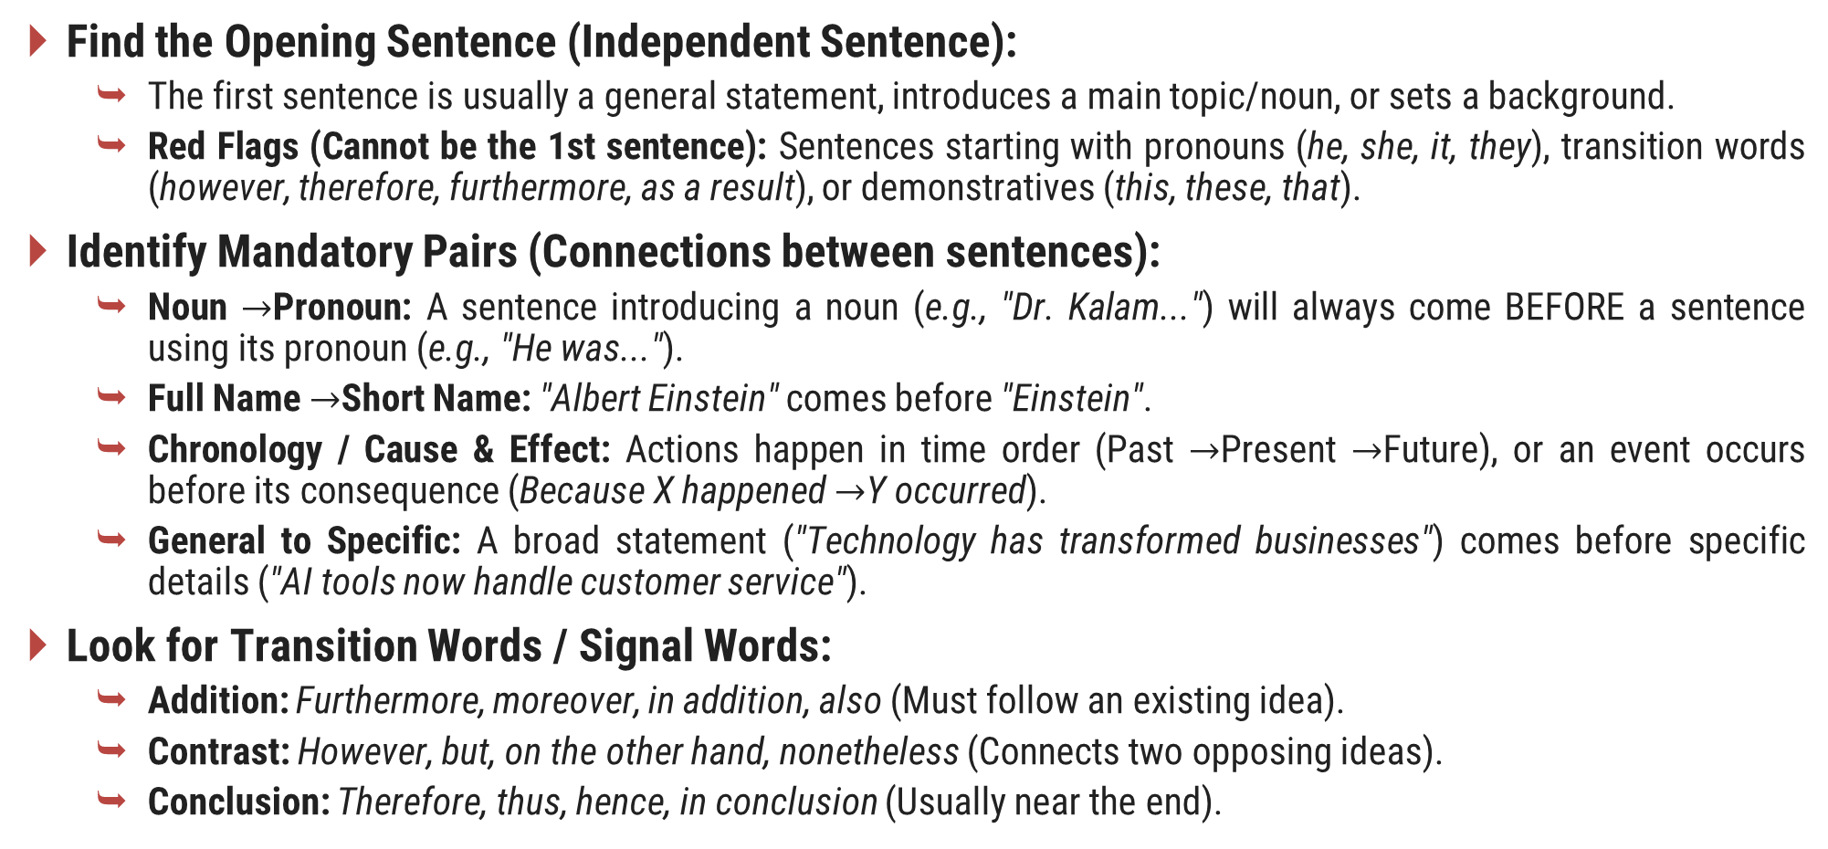
Tips
Find the Opening Sentence (Independent Sentence):
  The first sentence is usually a general statement, introduces a main topic/noun, or sets a background.
  Red Flags (Cannot be the 1st sentence): Sentences starting with pronouns (he, she, it, they), transition words (however, therefore, furthermore, as a result), or demonstratives (this, these, that).
Identify Mandatory Pairs (Connections between sentences):
  Noun $→$Pronoun: A sentence introducing a noun (e.g., "Dr. Kalam...") will always come BEFORE a sentence using its pronoun (e.g., "He was...").
  Full Name $→$Short Name: "Albert Einstein" comes before "Einstein".
  Chronology / Cause & Effect: Actions happen in time order (Past $→$Present $→$Future), or an event occurs before its consequence (Because X happened $→$Y occurred).
  General to Specific: A broad statement ("Technology has transformed businesses") comes before specific details ("AI tools now handle customer service").
Look for Transition Words / Signal Words:
  Addition: Furthermore, moreover, in addition, also (Must follow an existing idea).
  Contrast: However, but, on the other hand, nonetheless (Connects two opposing ideas).
  Conclusion: Therefore, thus, hence, in conclusion (Usually near the end).

Slide 5
Tips
Find the Closing Sentence:
  Look for a sentence that summarizes the main point, states a final result, or offers a concluding thought.

Slide 6
Practice
Question 1
A. However, without proper planning, these rapid changes can cause confusion among employees.
B. Digital transformation has become a top priority for modern enterprises.
C. Therefore, leadership must communicate the vision clearly to ensure a smooth transition.
D. Companies are adopting cloud computing and AI tools to increase efficiency.
Correct Sequence: B – D – A – C

Slide 7
Practice
Question 2
A. He noticed that many small business owners struggled to keep track of their daily expenses.
B. Today, his mobile application is used by over a million small vendors across the country.
C. To solve this, he developed a simple, user-friendly accounting app.
D. Rahul started his career as a freelance software developer in Pune.
Correct Sequence: D – A – C – B

Slide 8
Practice
Question 3
A. As a result, productivity drops and team members experience physical and mental fatigue.
B. While working extra hours may seem necessary during project deadlines, long-term overwork leads to burnout.
C. Organizations must encourage regular breaks and enforce clear boundaries between work and personal life.
D. Continuous stress without recovery time impairs a person's decision-making abilities.
Correct Sequence: B – D – A – C

Slide 9
Practice
Question 4
A. These attacks often trick employees into revealing sensitive corporate passwords.
B. Phishing remains one of the most common cyber threats facing organizations today.
C. Consequently, regular cybersecurity training is essential to help staff identify suspicious emails.
D. Attackers usually send fake messages that mimic legitimate communications from banks or managers.
Correct Sequence: B – D – A – C

Slide 10
Practice
Question 5
A. On the other hand, passive listening often leads to misunderstandings and missed project details.
B. Effective communication requires both active listening and clear expression.
C. When team members listen attentively, they can identify problems early and collaborate better.
D. Thus, developing strong listening habits is vital for professional success.
Correct Sequence: B – C – A – D

Slide 11
Practice
Question 6
A. This continuous feedback loop helps developers fix bugs before the software reaches customers.
B. In traditional software development, testing occurred only after the entire application was built.
C. Modern teams, however, integrate automated testing throughout the development process.
D. This older approach frequently delayed releases due to last-minute bug discoveries.
Correct Sequence: B – D – C – A

Slide 12
Practice
Question 7
A. It allows employees to work from anywhere while maintaining flexible daily schedules.
B. Nevertheless, remote work requires strong self-discipline to avoid distractions at home.
C. Without clear time management, the line between personal life and professional duties becomes blurred.
D. Remote work has fundamentally altered how modern companies operate.
Correct Sequence: D – A – B – C

Slide 13
Practice
Question 8
A. The board of directors reviewed the proposal during their quarterly meeting.
B. After a lengthy debate, they voted unanimously to approve the expansion budget.
C. The marketing team submitted a detailed plan to expand operations into European markets.
D. This funding will allow the company to establish regional offices in London and Berlin.
Correct Sequence: C – A – B – D

Slide 14
Practice
Question 9
A. Plastic waste takes hundreds of years to decompose in natural environments.
B. Consequently, marine life suffers severe harm as toxic microplastics contaminate the food chain.
C. Millions of tons of single-use plastic end up in oceans every year.
D. Switching to biodegradable materials is therefore critical for environmental preservation.
Correct Sequence: C – A – B – D

Slide 15
Practice
Question 10
A. This makes it difficult for consumers to distinguish between authentic reviews and paid promotions.
B. E-commerce platforms rely heavily on customer ratings to build buyer trust.
C. To combat this issue, platforms are deploying AI algorithms to detect fake testimonials.
D. However, many sellers attempt to manipulate rankings by purchasing fake positive reviews.
Correct Sequence: B – D – A – C

Slide 16
Practice
Question 11
A. Renewable energy sources, such as solar and wind power, are growing rapidly.
B. Furthermore, government subsidies have made installing solar panels far more affordable.
C. This growth is largely driven by falling technology costs over the past decade.
D. As a result, clean energy is becoming a viable alternative to fossil fuels worldwide.
Correct Sequence: A – C – B – D

Slide 17
Practice
Question 12
A. Unclear requirements can cause developers to build features that do not meet client needs.
B. Clear project specifications are essential before writing any lines of code.
C. Investing time in requirements gathering early saves money and avoids rework later.
D. Such misalignments lead to costly revisions and missed delivery deadlines.
Correct Sequence: B – A – D – C

Slide 18
Practice
Question 13
A. Over time, these small savings accumulate into a substantial financial safety net.
B. Building an emergency fund is a critical step in personal financial planning.
C. Financial experts recommend setting aside a small percentage of monthly income automatically.
D. This fund provides peace of mind during unexpected life events like job loss or medical emergencies.
Correct Sequence: B – C – A – D

Slide 19
Practice
Question 14
A. The candidate prepared thoroughly by studying the company's recent product launches.
B. Her detailed knowledge of the firm impressed the interviewing panel immensely.
C. Shortly after the final round, she received a formal job offer letter.
D. During the interview, she answered complex technical questions with complete confidence.
Correct Sequence: A – D – B – C

Slide 20
Practice
Question 15
A. However, improperly managed data collection poses severe threats to user privacy.
B. Data has become the most valuable asset for modern tech organizations.
C. Therefore, governments are enforcing stricter regulations like GDPR to safeguard personal information.
D. Companies use consumer data to personalize services and optimize their operational decisions.
Correct Sequence: B – D – A – C

Slide 21
Practice
Question 16
A. Frequent breaks allow the mind to process information and refresh cognitive focus.
B. Studying for hours without interruption actually decreases information retention.
C. The Pomodoro technique, for instance, recommends 25 minutes of study followed by a 5-minute rest.
D. Adopting this structured approach prevents mental burnout during long exam preparations.
Correct Sequence: B – A – C – D

Slide 22
Practice
Question 17
A. The company launched a new software product last month.
B. Due to these technical glitches, user ratings dropped sharply in the first two weeks.
C. However, initial users reported frequent application crashes and slow loading times.
D. The engineering team immediately released a patch to resolve the bugs and restore stability.
Correct Sequence: A – C – B – D

Slide 23
Practice
Question 18
A. Reading regularly exposes individuals to sophisticated vocabulary and varied writing styles.
B. This enhanced vocabulary allows people to express complex ideas more clearly in professional settings.
C. Consequently, strong readers often demonstrate superior written and verbal communication skills.
D. Developing a consistent reading habit is one of the best ways to improve language proficiency.
Correct Sequence: D – A – B – C

Slide 24
Practice
Question 19
A. Without proper documentation, maintenance becomes difficult when original developers leave the team.
B. Code documentation is often neglected by developers under tight project deadlines.
C. Writing clear comments and system manuals ensures long-term software maintainability.
D. Therefore, engineering leads must enforce documentation standards as part of the code review process.
Correct Sequence: B – A – C – D

Slide 25
Practice
Question 20
A. Electric vehicles produce zero tailpipe emissions during operation.
B. As battery prices drop and charging infrastructure expands, EV adoption is surging worldwide.
C. This makes them a cleaner alternative to traditional gasoline-powered cars.
D. Transportation accounts for a significant portion of global greenhouse gas emissions.
Correct Sequence: D – A – C – B

Slide 26
Practice
Question 21
A. It allows employees to access files and software from any location.
B. This flexibility has fundamentally changed how modern teams operate.
C. Cloud computing has transformed corporate operations across the globe.
D. As a result, geographic barriers no longer limit project collaboration.
Correct Sequence: C – A – B – D

Slide 27
Practice
Question 22
A. To prevent this, developers perform rigorous code reviews before deployment.
B. A single unhandled exception can cause an entire application to crash.
C. Software errors can lead to severe operational disruptions for businesses.
D. Peer reviews help identify hidden bugs early in the development cycle.
Correct Sequence: C – B – A – D

Slide 28
Practice
Question 23
A. He spent months analyzing customer behavior to refine the user interface.
B. Arjun launched an e-commerce platform for local artisans in 2021.
C. This dedication resulted in a 40% increase in monthly active users.
D. Initial feedback indicated that the website layout was too confusing.
Correct Sequence: B – D – A – C

Slide 29
Practice
Question 24
A. These notifications often shatter focus and reduce overall task performance.
B. Constant digital interruptions make it difficult to maintain deep concentration.
C. Turning off non-essential alerts allows workers to regain control over their time.
D. Smartphones constantly chime with social media updates and unread emails.
Correct Sequence: B – D – A – C

Slide 30
Practice
Question 25
A. However, excessive consumption can lead to sleep disturbances and anxiety.
B. Caffeine is one of the most widely consumed natural stimulants worldwide.
C. Consequently, health experts recommend limiting intake to reasonable daily amounts.
D. It helps people feel more alert and less tired by blocking fatigue signals.
Correct Sequence: B – D – A – C

Slide 31
Practice
Question 26
A. This rapid feedback loop allows developers to release software patches in hours rather than months.
B. Traditional software updates used to take months to design and distribute.
C. Modern CI/CD pipelines automate the testing and deployment phases completely.
D. Developers now push code updates into production multiple times a day.
Correct Sequence: B – C – D – A

Slide 32
Practice
Question 27
A. Investing in clean energy infrastructure creates thousands of green jobs.
B. Shifting away from fossil fuels is necessary to combat climate change.
C. Therefore, governments should incentivize clean energy investments immediately.
D. Beyond environmental benefits, this transition offers substantial economic growth.
Correct Sequence: B – D – A – C

Slide 33
Practice
Question 8
A. The candidate explained how she managed a cross-functional team during a crisis.
B. Her structured communication style impressed the hiring managers.
C. Priya walked into the interview room feeling confident and well-prepared.
D. As a result, she was offered the senior team lead position later that day.
Correct Sequence: C – A – B – D

Slide 34
Practice
Question 29
A. Without adequate sleep, the brain struggles to consolidate memories effectively.
B. Sleep plays a crucial role in maintaining optimal cognitive function.
C. Prioritizing 7 to 8 hours of rest ensures high daily mental performance.
D. This leads to noticeable memory lapses and reduced decision-making speed.
Correct Sequence: B – A – D – C

Slide 35
Practice
Question 30
A. High customer churn rates indicate underlying dissatisfaction with a service.
B. By listening to complaints, businesses can fix flaws before losing more users.
C. Therefore, tracking user churn is vital for long-term customer retention.
D. Analyzing exit feedback provides valuable insights into user frustrations.
Correct Sequence: A – D – B – C

Slide 36
Thank You

